Slide 1
Travel Tips and Tricks
Sunny Day Travel, LLC

Slide 2
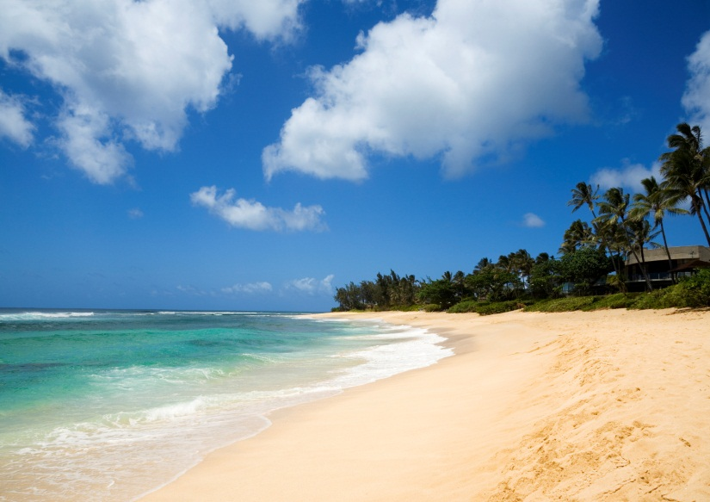
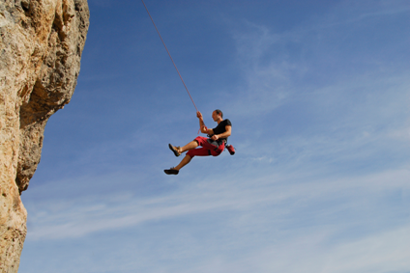
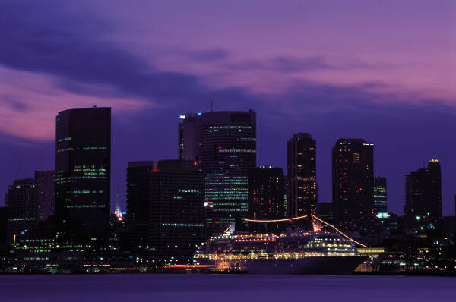
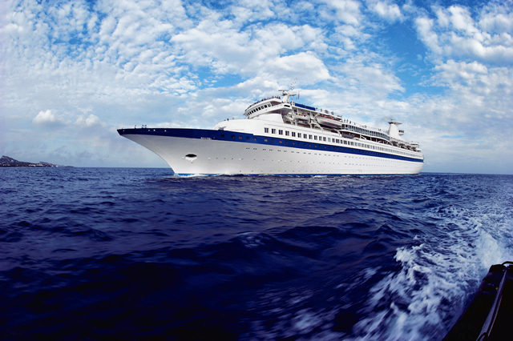
Where Do You Want to Go?
Sand and Sun
Adventure
City
Cruise

Slide 3
Sand and Sun
Sunscreen, sunscreen, sunscreen!
Pack for warm weather—but also for cool evenings
Take an extra swimsuit
Research local tours and charters in advance

Slide 4
Sand and Sun 2
Take flip-flops or other shoes that can get wet, and that dry quickly
Beach time can be hard on your hands and feet
Pack a small first-aid kit for minor cuts
Take plenty of lotion for dry skin
Sunscreen and more sunscreen!

Slide 5
Sand and Sun 3

Slide 6
Adventure 1

Slide 7
Adventure 2

Slide 8
Adventure 3

Slide 9
Cruise 1

Slide 10
Cruise 2

Slide 11
Cruise 3

Slide 12
City 1

Slide 13
City 2

Slide 14
City 3

Slide 15
Enjoy Your Trip!

